Slide 1
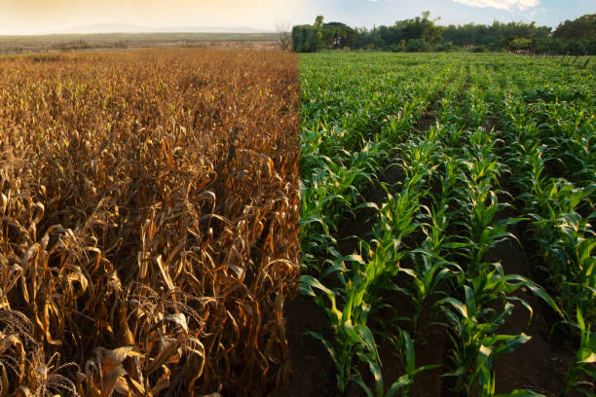


Climate-Adaptive Agriculture: A Global Predictive Platform for Sustainable Farming
Research Proposal Presentation
MSc Data Science- Research Methods and Professional Practice July 2025 B
Presented by Naveed Jamal
University of Essex Online | October 2025

Slide 2
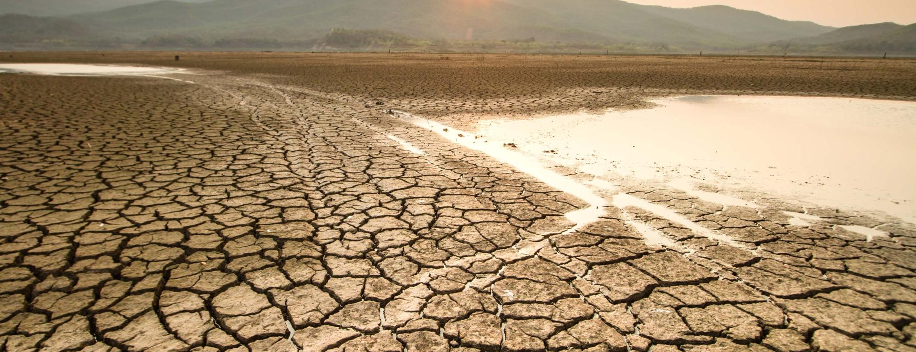
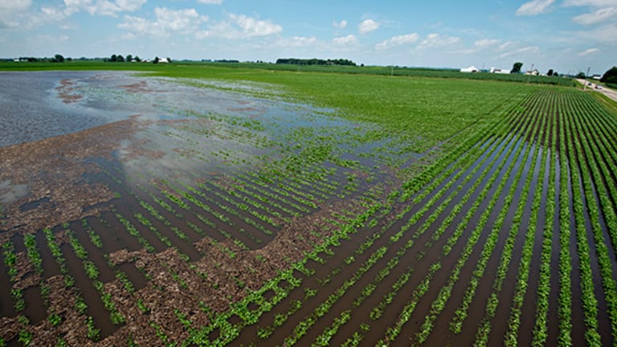
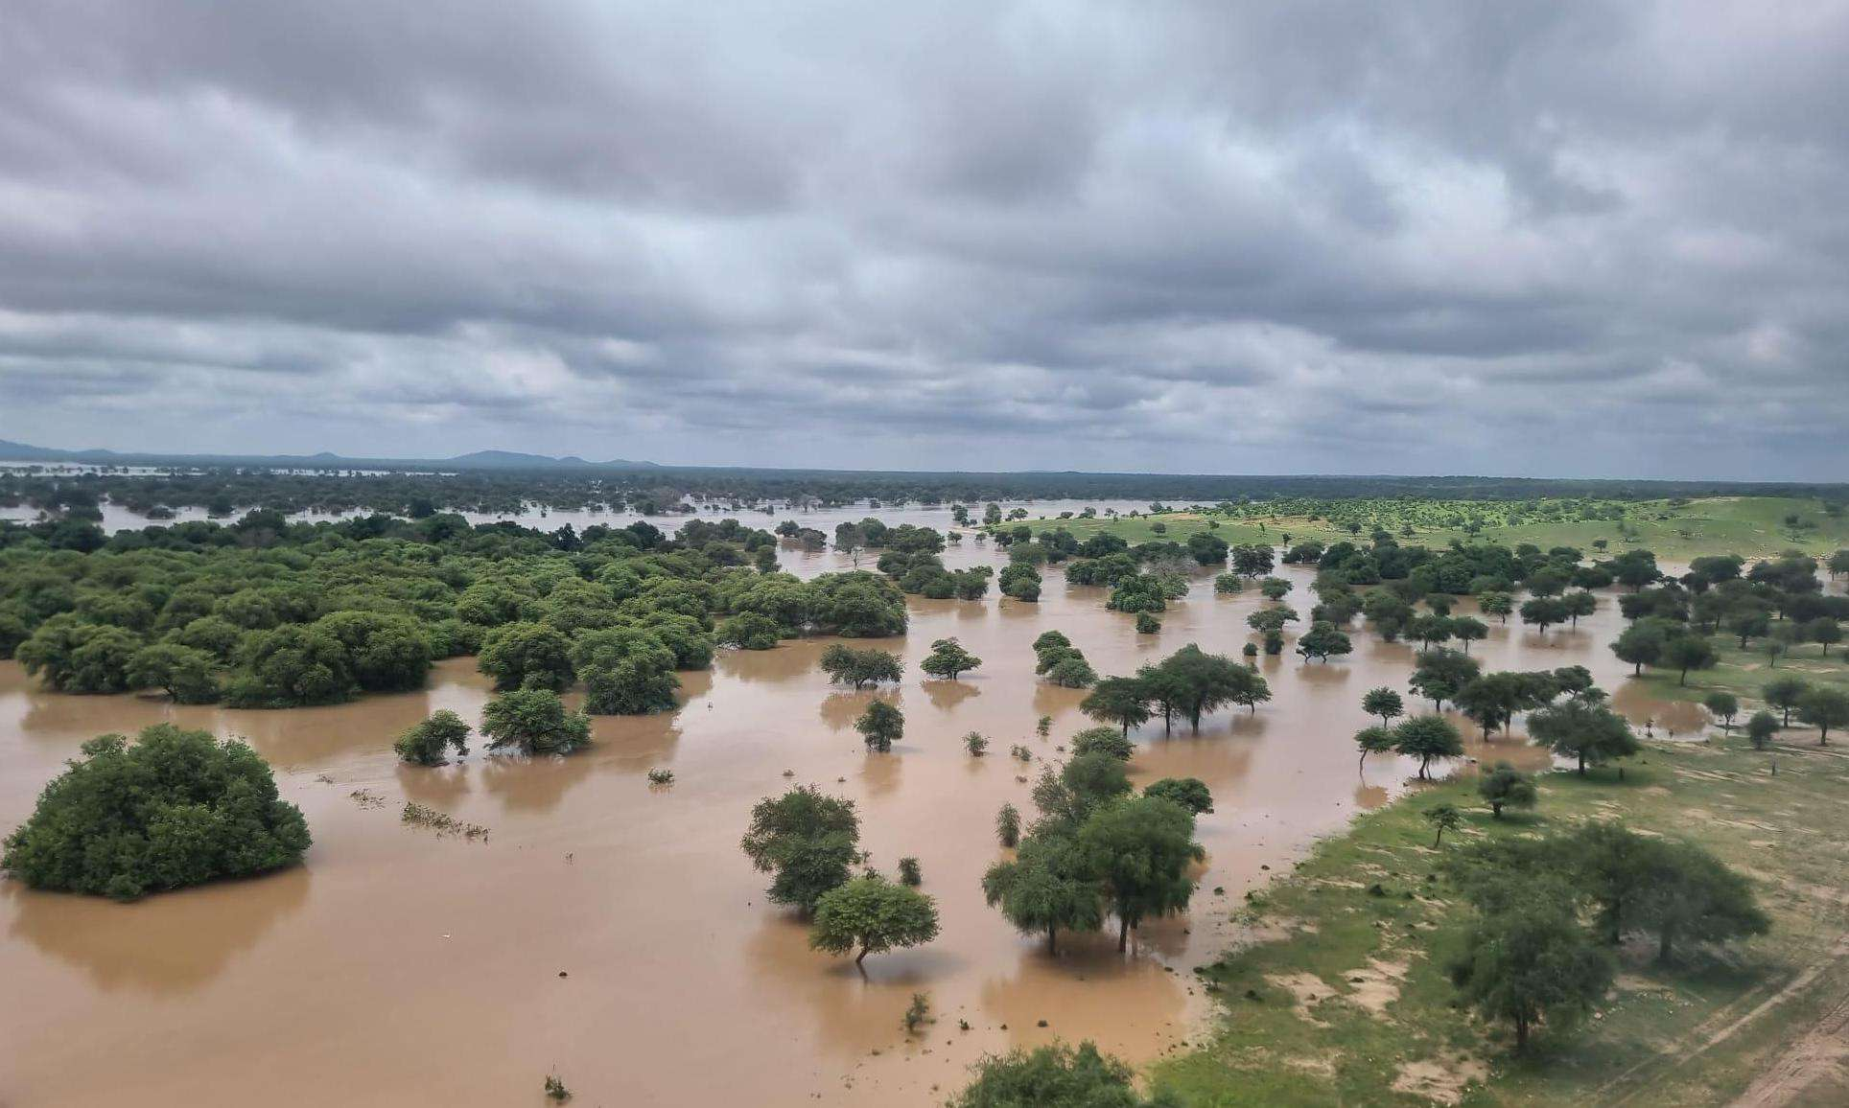

Why Predictive Climate Tools Are Urgently Needed
Climate change increasing global yield losses (FAO, 2023)
Limited access to localized decision-support tools for farmers
Lack of integration between climate, soil, and satellite data
Global need for AI-driven adaptation strategies

Slide 3
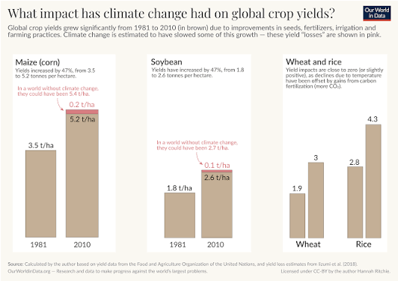
Yield Suppression: Climate Change Dragging Growth
Climate has already reduced yields — Corn, soy, wheat etc.
Losses small in % but significant in volume/potential yield later
Future temperature rise → larger projected yield drops (especially Corn)

Slide 4
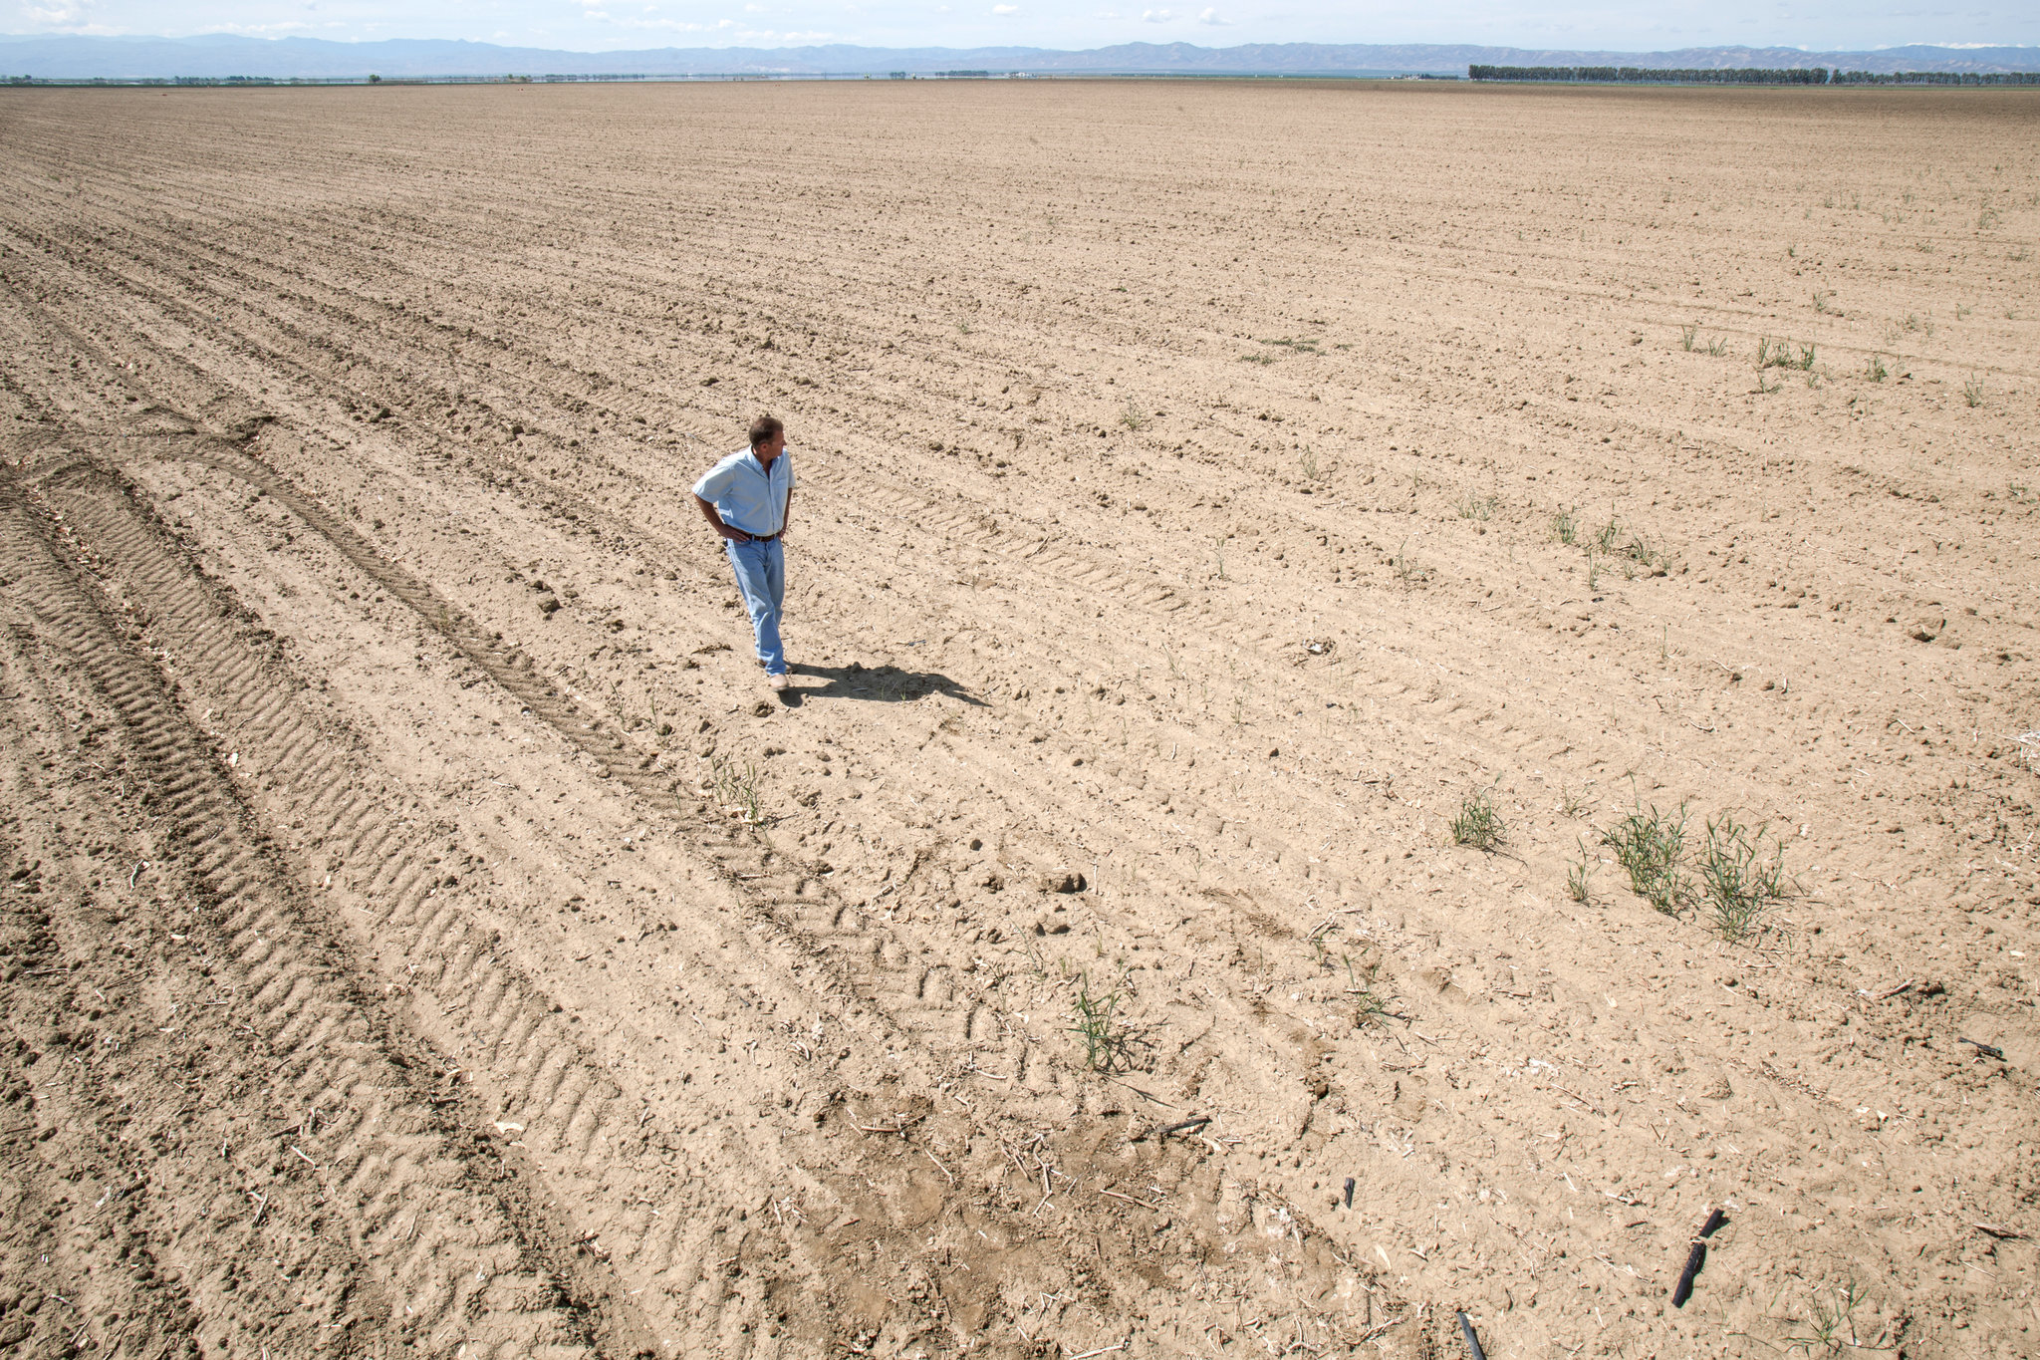
Significance and Research Problem
🌾 Global food demand is projected to rise by over 50% by 2050.
🌍 Climate change threatens yields, with losses up to 30–50% in vulnerable regions.
💡 Need for adaptive, data-driven farming decisions to improve resilience and sustainability.

Slide 5
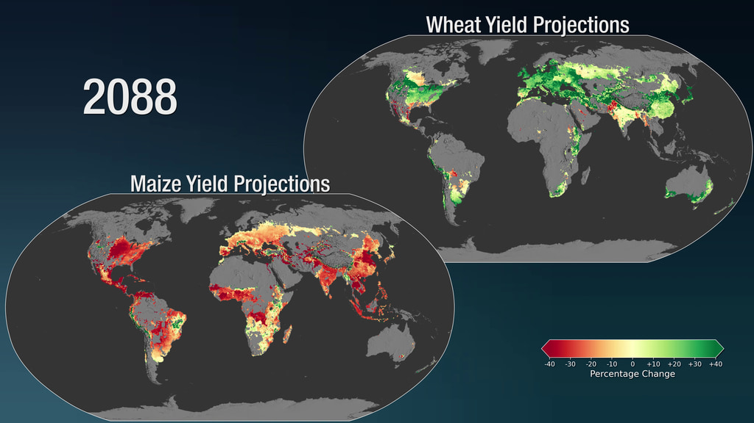
Research Question, Aim, and Objectives
Research Question: How can data-driven predictive models help optimize crop planting times and improve agricultural yield resilience under changing climate conditions globally?
Aim: To design and evaluate a globally scalable predictive system that supports farmers in adapting planting strategies to climate variability using machine learning and environmental data.
Objectives:
Collect and analyze global climate and agricultural datasets from diverse regions (e.g., Asia, Africa, the Americas, and Europe).
Identify key environmental and agronomic factors influencing crop yields.
Develop and test predictive models to forecast optimal planting times and yield outcomes.
Design a prototype interface that visualizes model outputs for farmer use.
Evaluate the system’s potential impact on resilience and sustainability.
This research contributes to climate adaptation and sustainable agriculture through applied data science.

Slide 6
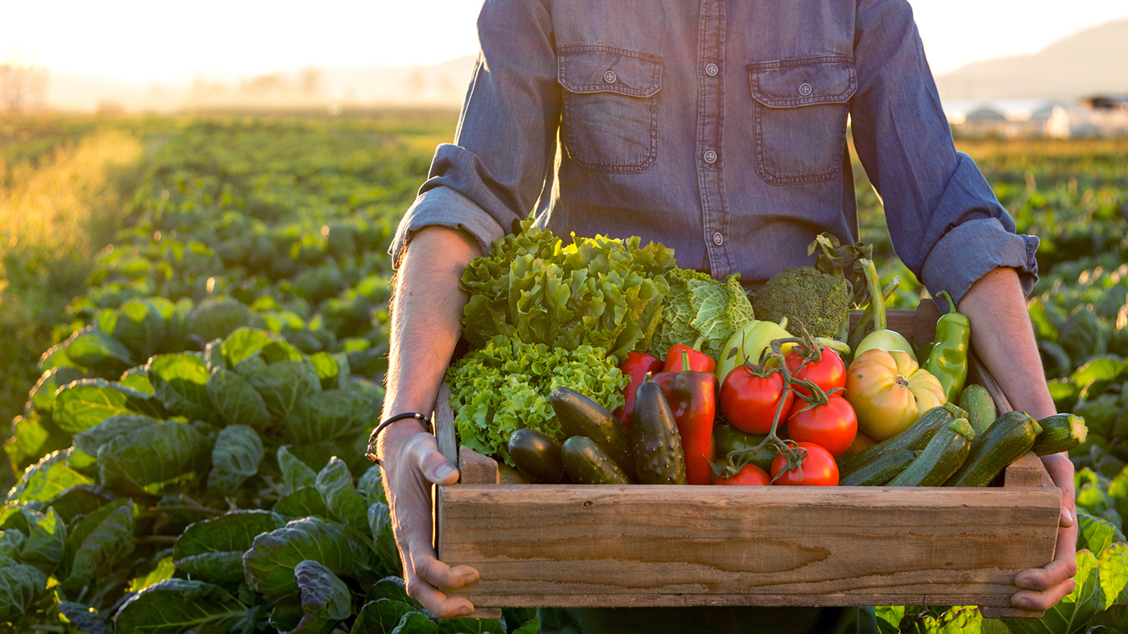

Existing Research and Theoretical Foundation
Machine Learning in Agriculture – Advances in yield prediction, disease detection, and precision farming (Liakos et al., 2018; Shahhosseini et al., 2021).
Climate Impact on Crop Productivity – Empirical evidence of yield loss due to rising temperature and rainfall variability (IPCC, 2022; Lobell et al., 2011).
Spatio-Temporal Data Integration – Need for models that capture both geographic and time-based variation (Zhong et al., 2019).
Explainable AI and Trust – Farmers must understand why models make specific recommendations (SHAP, LIME frameworks).
Research Gap – No comprehensive, interpretable model predicting optimal planting time across global contexts.

Slide 7
From Data to Decision: Building the Predictive Framework
Data Collection
Model Evaluation
Prototype Design and Feedback
Data Preproccesing
Model Development
Approach Overview:
Mixed-method, quantitative design using machine learning & open climate data.
Focus on predictive modeling and explainable AI (XAI) for transparency.
Data Sources:
FAO, NASA EarthData, NOAA, Copernicus Climate Data Store, and local agricultural datasets.
Techniques:
Random Forests, Gradient Boosting, and CNNs for spatio-temporal patterns.
SHAP/LIME for interpretability and farmer trust.
Validation:
Cross-validation with regional data.
Performance metrics: RMSE, MAE, and feature importance analysis.
Output:
Interactive prototype visualizing recommended planting windows.

Slide 8
Proposed Artefact: Climate-Adaptive Predictive Platform
Climate Data
Crop Data
ML Engine
Mobile Dashboard
Artefact Overview:
Prototype: Predictive Decision Support Platform for Agriculture
Core functions:
Integrate global climate & soil datasets
Predict optimal planting windows per region
Provide explainable insights using SHAP/LIME
Offer a simple, multilingual farmer interface
Technologies:
Python, TensorFlow / Scikit-learn, Streamlit / Power BI for visualization
Backend: Cloud-based data processing (AWS or Google Cloud)
Intended Users:
Farmers, agricultural extension officers, and policymakers

Slide 9
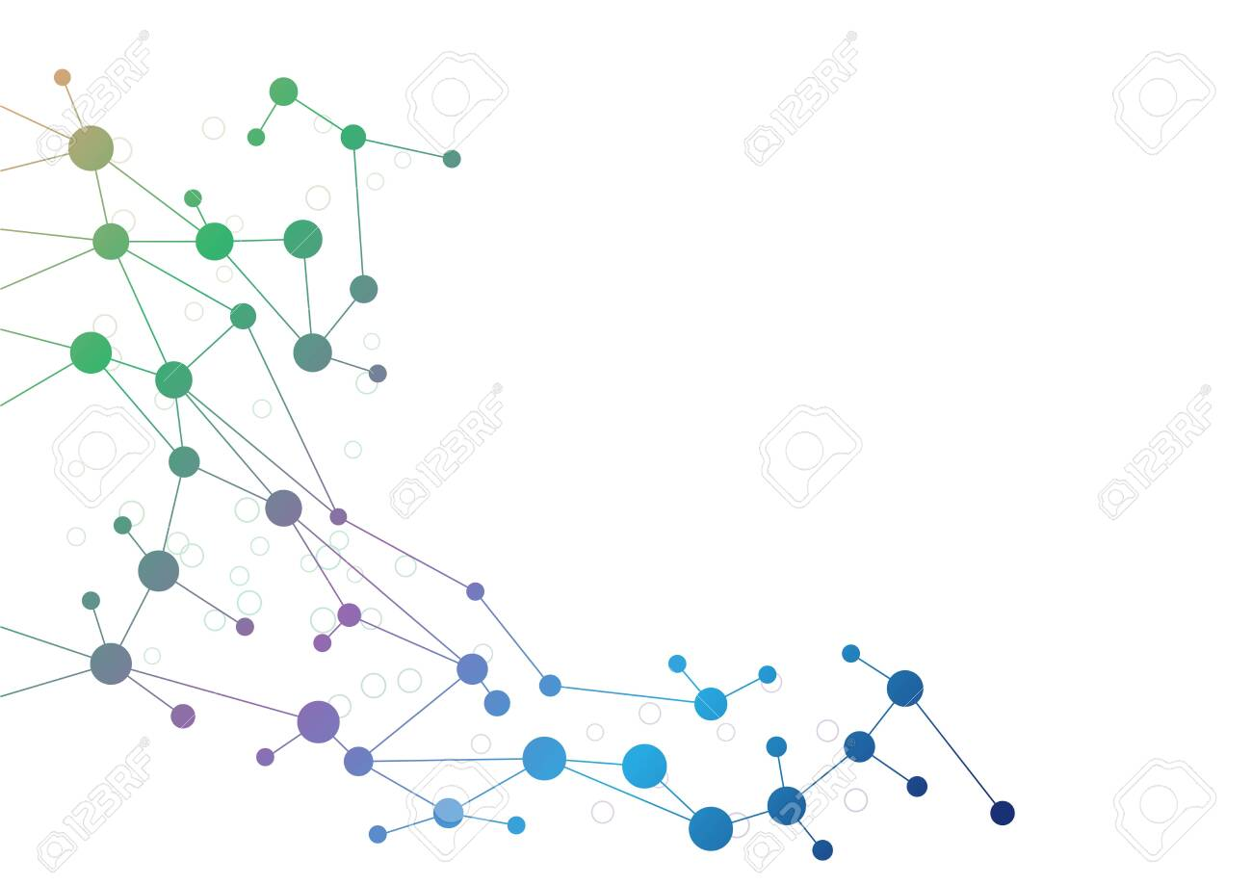
Ethical and Risk Management Framework
Data Ethics
Use only open-access, anonymized datasets (FAO, NASA, NOAA).
Ensure GDPR compliance and transparency in data usage.
Algorithmic Fairness
Avoid regional or crop bias by training on diverse global datasets.
Incorporate explainable AI (SHAP, LIME) to enhance trust.
Environmental & Social Impact
Support sustainable resource management.
Promote equitable access for smallholder farmers.
Risk Management
Risks: Data inaccuracy, overreliance on AI, misinterpretation.
Mitigation: Model validation, clear disclaimers, continuous updates.

Slide 10
30-Week Research Timeline (Oct 2025 – Apr 2026)
Phase | Weeks | Approx. Dates | Key Activities / Deliverables
1. Proposal Finalization & Ethics Approval | 1 – 4 | Oct 2025 | Finalize research plan, Approval.
2. Literature Review & Framework Design | 5 – 8 | Nov – early Dec 2025 | Conduct in-depth review, define methodology, select datasets.
3. Data Collection & Preprocessing | 9 – 12 | Dec – Jan 2026 | Acquire FAO/NASA data, clean and integrate for modelling.
4. Model Development | 13 – 17 | Feb – mid-Mar 2026 | Train Random Forest / XGBoost / CNN models for prediction.
5. Evaluation & Explainability | 18 – 21 | mid-Mar – Apr 2026 | Validate accuracy, apply SHAP/LIME for interpretability.
6. Artefact Development & User Testing | 22 – 26 | Apr – May 2026 | Build Power BI prototype; conduct pilot feedback.
7. Final Analysis & Dissertation Writing | 27 – 30 | May – Jun 2026 | Summarize findings, finalize report

Slide 11
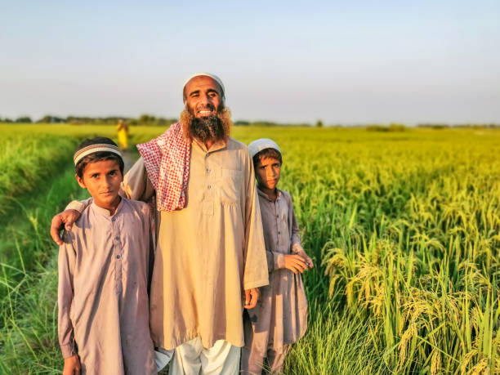

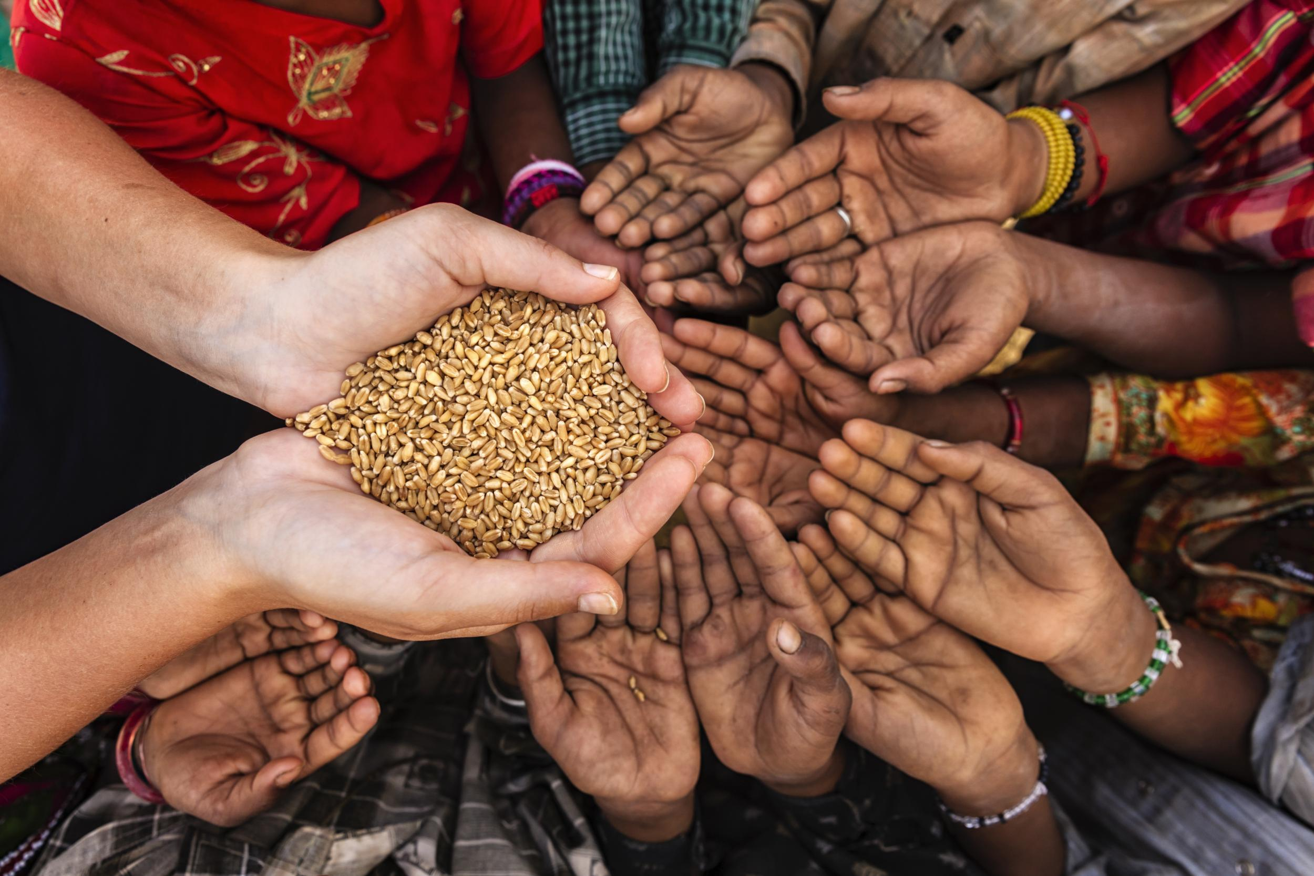



From Local Prototype to Global Climate Resilience
Future Vision
Scale model for global deployment using region-specific data hubs.
Collaborate with agricultural ministries and NGOs for localization.
Integrate with IoT sensors and satellite systems for real-time adaptation.
Contribute to UN SDGs: Zero Hunger (2), Climate Action (13), Innovation (9).
Vision: A global AI-powered ecosystem empowering farmers and strengthening food resilience.

